Slide 1
Coding and Software Appendix
Built from L1, L3, SLR Block, and MLR Block
Commands, Packages, Notebooks, and Hands-On Workflow

Slide 2
Programming Software
Python is the primary workflow (ISLP textbook)
R is essential for OA4106 next quarter
We will work with both
VS Code / Github Codespace
Assignments
May be done in either Python or R
Some small tasks will explicitly ask for both

Slide 3
Data Cleaning: Python and R tools
Loading a dataset as a Dataframe
Python:
import pandas as pd
df = pd.read_csv(“filename.csv”)
-or-
df = pd.read_csv(“filename.csv”, na_values=[“”, ”NA”, “N/A”])
R:
df <- read.csv(“filename.csv”)
-or-
df <- read.csv("filename.csv", na.strings = c("", "NA", "N/A"), stringsAsFactors = FALSE)

Slide 4
Identifying and handling missing values
Python
df.isna().sum() Counts NaN values
df = df.replace(0, np.nan) Converts zeros to NaN
df = df.dropna() Removes rows containing at least one NaN
R:
colSums(is.na(df)) Counts NA values
df[df == 0] <- NA Converts zeros to NA
df <- drop_na(df) Removes rows containing at least one NA

Slide 5
Identifying and handling missing values
Dropping rows if specific columns are missing:
Python
df = df.dropna(subset=["Age", "Weight_lbs"])
R:
df <- drop_na(df, Age, Weight_lbs)

Slide 6
Detecting and Fixing data types
Python
df.dtypes
df["col"] = df["col"].astype(float)
df["category"] = df["category"].astype("category")
df["date"] = pd.to_datetime(df["date"])
R:
str(df)
df$col <- as.numeric(df$col)
df$category <- factor(df$category)
df$date <- as.Date(df$date, format = "%Y-%m-%d")
Technique: Import as strings first, clean values, then convert to numeric or factor once the column is trustworthy.

Slide 7
Renaming and standardizing columns
Nonstandardized column titling
“college” vs “school” vs “university”
“miles” vs “Miles_Driven”
Python:
df = df.rename(columns{“college”: “school”})
df = df.rename(columns{“Miles_Driven”: “miles”})
R:
df <- df %>% rename(school = college)
df <- df %>% rename(miles = Miles_Driven)

Slide 8
Subsetting rows and columns
Filter rows, select columns, or create new variables
Python
df[df["strength"] == 1]
df[["miles", "population"]]
df["mpd"] = df["miles"] / df["population"]
R
df %>% filter(strength == 1)
df %>% select(miles, population)
df <- df %>% mutate(mpd = miles / population)

Slide 9
Other Data Cleaning Tools
String cleaning
Trimming whitespace
Fixing capitalization
Standardizing Naming Conventions
e.g., “NYC” vs “New York City” or “LA” vs “Los Angeles”
Duplicate detection
Python: import pandas as pd R: library(dplyr)
df_unique = df.drop_duplicates() df_unique <- df %>% distinct()
df_cities = df.drop_duplicates(subset=["City", "State"]) df_cities <- df %>% distinct(City, State)
df_users <- df %>% distinct(UserID, .keep_all = TRUE) df_users = df.drop_duplicates(subset=["UserID"], keep="first")
Saving cleaned data
e.g., “Pima2” from Lab 1

Slide 10
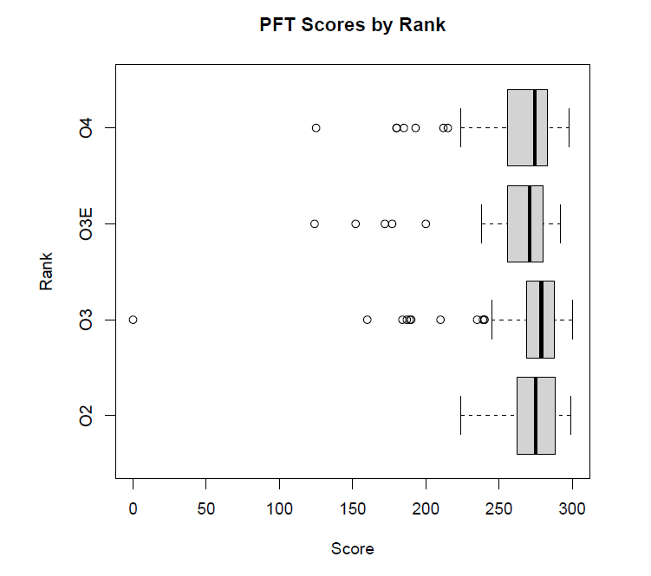
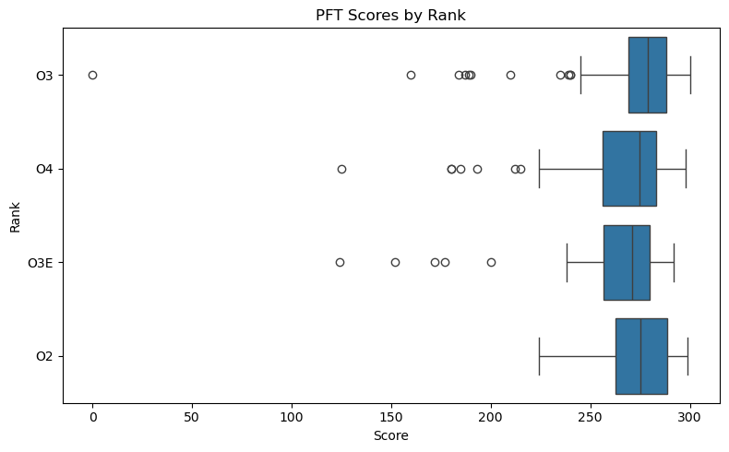
Grouped box plot
Categorical / Ordinal $×$ Numerical
R:
boxplot(pft_data$score ~ pft_data$rank, + horizontal=T, xlab=“Score”, ylab=“Rank”, + main=“PFT Scores by Rank”)
Python:
import seaborn as sns
import matplotlib.pyplot as plt
plt.figure(figsize=(8, 5))
sns.boxplot(
data=pft_data,
x="score", # horizontal axis
y="rank", # grouping variable
orient="h" # horizontal orientation
)
plt.xlabel("Score")
plt.ylabel("Rank")
plt.title("PFT Scores by Rank")
plt.tight_layout()
plt.show()
Image source: R (top) and Python/Seaborn (bottom) plots from the pft.csv dataset.

Slide 11
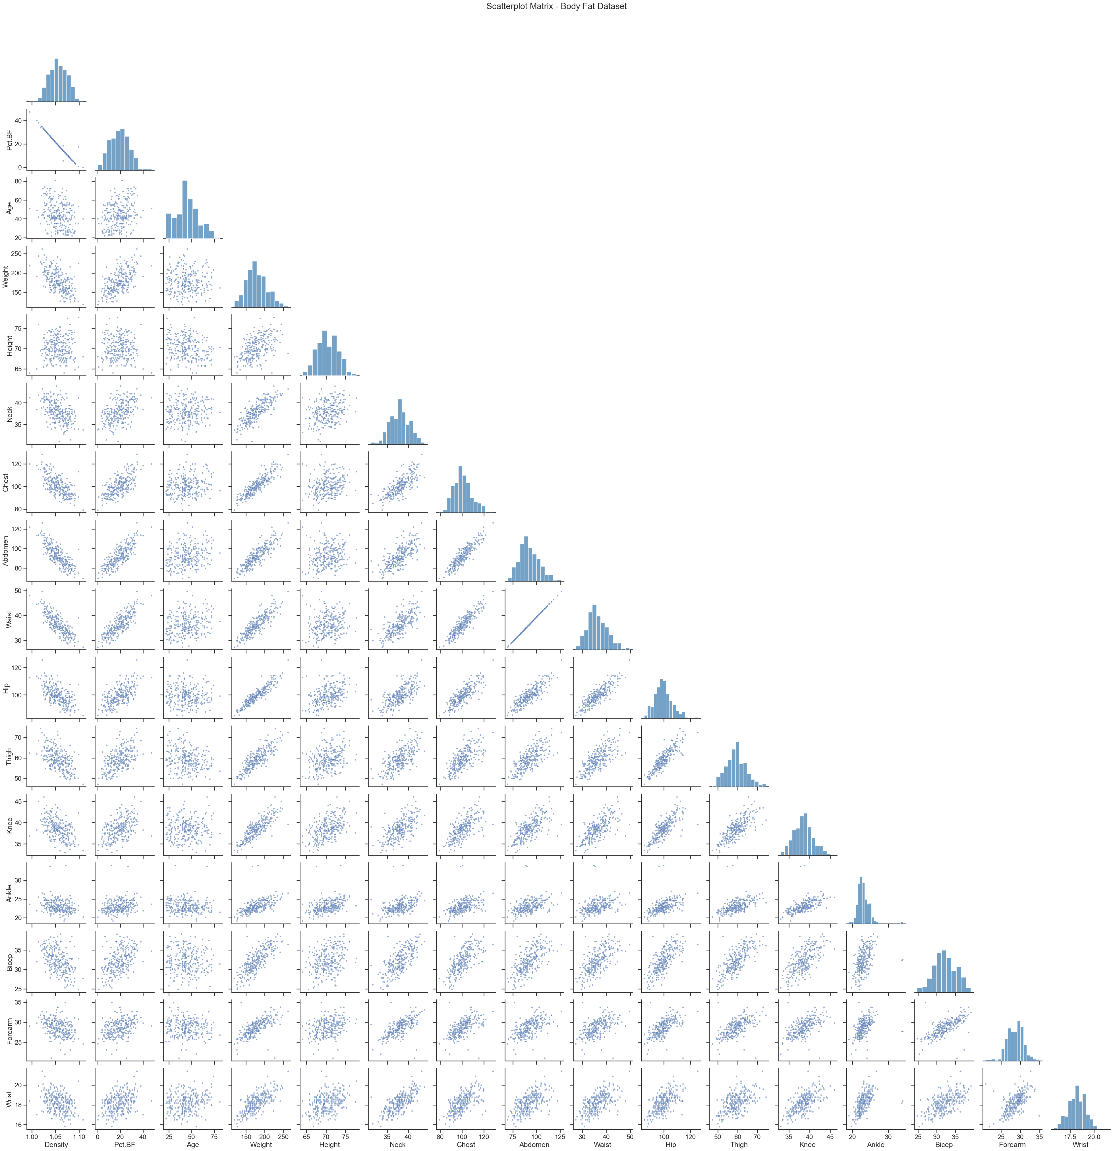
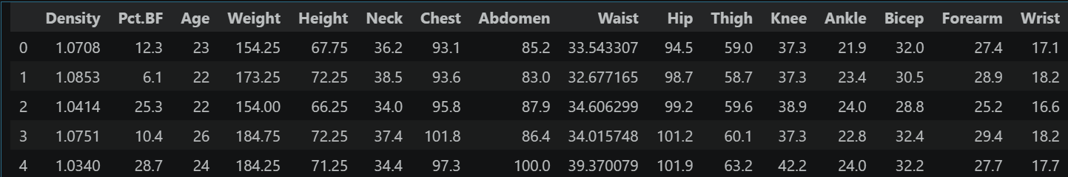
Scatterplot Matrix
Python:
head(body_fat)
16 numerical variables
Why are the diagonal entries histograms?

Slide 12
Back to Python/R
With the pft.csv data:
Build a histogram of the pft scores
Overlay the mean, median, and standard deviation lines
Verify the empirical rules and/or Chebyshev’s rule
Create a grouped boxplot of the score and gender variables.
Using the pima dataset from the faraway package:
Run a quick cleaning of the data
Zeros as missing: “triceps”, “insulin”, “bmi”
Create a correlation heatmap
(Time permitting) Save the clean pima data as a csv and create a pairplot and correlation heatmap in Python using seaborn

Slide 13
Biased vs Unbiased Estimators
Variance and Covariance Defaults in R and Python- It turns out different packages use different calculations for $Var$ and $Cov$:
Ecosystem / Package | Variance Code / Default Setting | Covariance Code/ Default Setting | Reasoning
R (base) | var | cov | Classical statistics; inference-oriented
 | Unbiased (n-1) | Unbiased (n-1)
Python/Pandas | Series.var | DataFrame.cov | Classical statistics defaults
 | Unbiased (n-1) | Unbiased (n-1)
Python/NumPy | np.var | np.cov | Numerical linear algebra roots; MLE for
 | Biased (n) | Unbiased (n-1) | variance, known historical inconsistency
Python/sklearn | Biased (n)* | Biased (n)* | ML-oriented; optimization over inference, MLE
Python/statsmodels | Unbiased (n-1)* | Unbiased (n-1)* | Designed to mirror R; inference oriented.
*internally: no specific code to calculate variance/covariance

Slide 14
Do we need to mindfully select the correct package in R and/or Python?
Fortunately, no.
The functions we use (ex: lm() in R) automatically select the correct interpretation.
We will (hopefully) rarely directly calculate $Var$ or $Cov$ for our analyses.

Slide 15
Follow-up From Yesterday #3
How does covariance between observed $x_{i}$ and $y_{i}$ affect the slope parameter $β_{1}$?
Explore the Slope vs Cov and Var.ipynb file in Sakai.

Slide 16
Back to R and Python
I will introduce the basic commands for doing an SLR fit in R, followed by Python.
Jupyter Notebook - Simulation to explore effects of $Var(x)$ and $Cov(x,y)$ on slope.
Examine datasets of your choice in R and Python.
You should now have all the tools you need to complete HW1.

Slide 17
What about the t-tests?
In R and Python/statsmodels, we see linear model summary output with t-test p-values as well.
For SLR, the t-test for ${\hat{β}}_{1}$ is mathematically equivalent to the F-test.
In MLR, they diverge. We will get into that later this week.

Slide 18
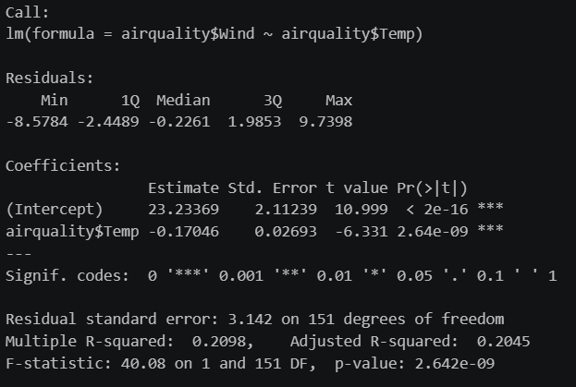
R Output
Recall that in R we use the fit <- lm()command. The summary of that fit looks like this:
The Y (response) regressed onto X (predictor).
The distribution of the residuals.
The fitted ${\hat{β}}_{0}$ y-intercept value.
The fitted ${\hat{β}}_{1}$ slope value. Note that its t-statistic has the same p-val as the F-statistic.
The $R^{2}$value. More on adjusted $R^{2}$ in MLR.
F-statistic and its p-value.

Slide 19
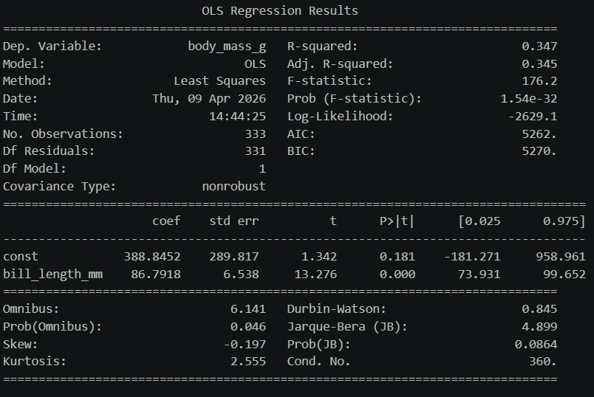
Python Output
In Python, with statsmodels imported as sm, we build a design matrix (more on that tomorrow) and the output looks like:
The Y (response) is the dependent variable.
The X (predictor) variable.
The $R^{2}$value.
F-statistic and its p-value.
The fitted ${\hat{β}}_{0}$ y-intercept value.
The fitted ${\hat{β}}_{1}$ slope value.

Slide 20
Back to R and Python
Open up your notebooks and datasets from Thursday.
Using visual EDA (scatterplot matrices and/or correlation heatmaps), compare $R^{2}$ values and F-test p-values between different variables.

Slide 21
Clarification / Clean Up
R: drop = FALSE
We used this in the train/test split code yesterday for selecting a single column of data.
If we take a subset of data that consists of only one column, R likes to convert it to a vector.
This causes issues for lm() and model.matrix() because they expect data frames
x_train <- df[1:3, ] returns a vector
x_train <- df[1:3, , drop =FALSE] preserves a data frame
In other words, R defaults to drop = TRUE

Slide 22
Start with EDA
Advertising.csv is a cleaned dataset:
> # Do any of the columns in advertising have missing values?
> colSums(is.na(advertising))
X 0 TV 0 Radio 0 Newspaper 0 Sales 0

Slide 23
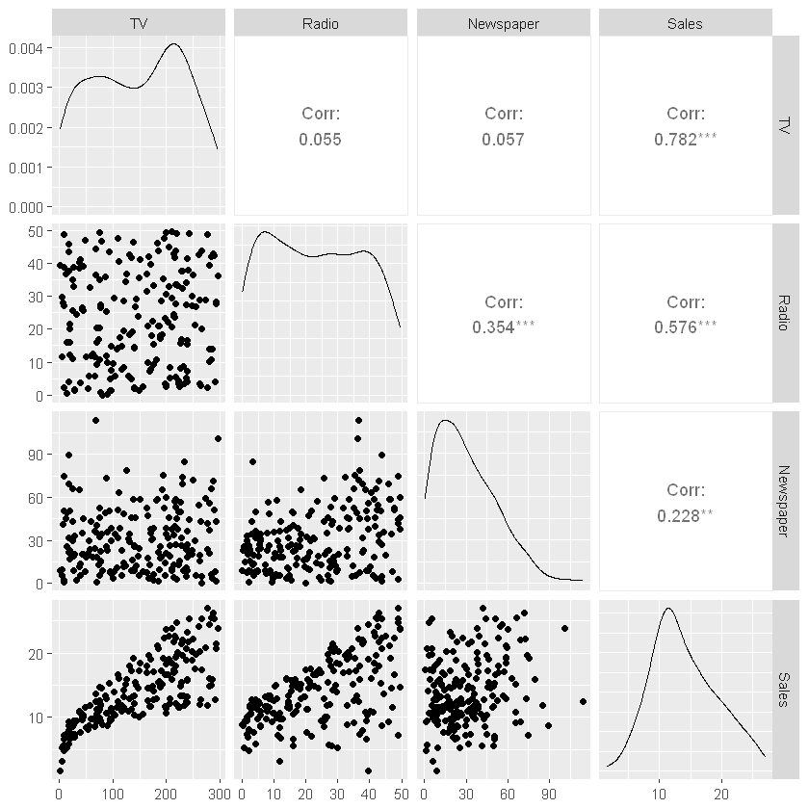
ggpairs
GGally package in R

Slide 24
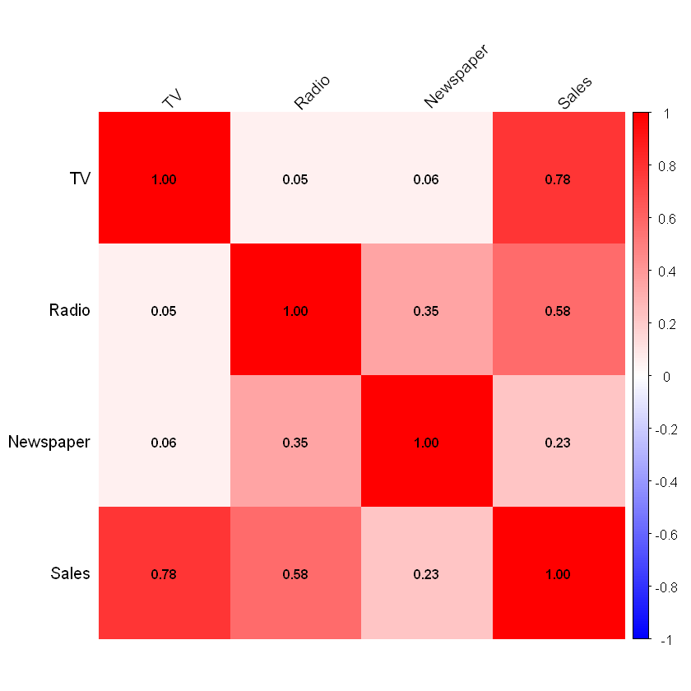
Correlation Heatmap
corrplot package in R

Slide 25
New Commands
In R, we build an MLR model with
lm(Y ~ X1 + X2 + … + Xp)

Slide 26
New Commands
In Python, we want to decide if we are doing inference or prediction.
For inference we use the statsmodels package:
import statsmodels.formula.api as smf
fit = smf.ols("Y ~ X1 + … + Xp", data=df).fit()
* When using the formula interface, we don’t need to build a design matrix manually.

Slide 27
New Commands
In Python, we want to decide if we are doing inference or prediction.
For prediction we use sklearn:
from sklearn.linear_model import LinearRegression
model = LinearRegression()
model.fit(df[["X1", "X2", "X3"]], df["Y"])
*No summary output like in R lm() or statsmodels.

Slide 28
Bivariate Model - Software Note
This plot can be produced with the plot3d and faraway packages, using the script Manilius.R which is posted on Sakai.

Slide 29
Residual Analysis - Implementation Note
In R or Python: Identify predictors with bad residuals and build new columns. Regress onto those instead.

Slide 30
The stackloss Dataset
R:
data(stackloss)
head(stackloss)
Python:
import statsmodels.api as sm
stackloss = sm.datasets.stackloss.load_pandas().data
stackloss.head()

Slide 31
Recall that Linear Model Fits are Objects
R:
fit <- lm(Y ~ X1 + X2, data = df)
resid(fit)
Python:
X=sm.add_constant(df[[“X1”,”X2”]])
fit=sm.OLS(Y, X).fit()
resid = fit.resid

Slide 32
Residual Diagnostic Tools – Hands On
Do/try the following:
Basic EDA (stackloss is a clean dataset)
SLR and MLR
Plot residuals against:
Raw Y
Fitted Y
Predictor(s)
Add a new column by transforming a predictor that looks like it might benefit from it.
Ex: stackloss$log_airflow <- log(stackloss$Air.Flow)
Repeat the above. How did you do?

Slide 33
Residual Diagnostic Tools – Hands On
Try the following in R:
fit <- lm(stack.loss ~ Air.Flow + Water.Temp + Acid.Conc., data=stackloss)
plot(fit)
What do we get from this?

